Slide 1



Coffee Shop Sales Analysis
Presented by Raveen D Pitawala

Slide 2



Contents
Overview of Sections
01
Introduction
02
Data Understanding
03
Exploratory Data Analysis
04
Time Series
05
Business Recommendations
06
Conclusion and References

Slide 3



Project Introduction
This project focuses on analyzing coffee shop sales data to enhance decision-making through predictive modeling and data-driven insights.
ANALYSIS OF COFFEE SHOP SALES DATA ACROSS MULTIPLE LOCATIONS
Our objective is to identify sales trends, enhance operational efficiency, and develop effective marketing strategies by generating actionable insights through data cleaning, exploratory analysis, customer segmentation, and time series forecasting

Slide 4



Data Quality
149,115
Total records after cleaning process
The coffee shop sales dataset contains transaction-level data, where data quality is ensured for accurate analysis.
Key engineered features include datetime, total price, profit metrics, and customer ID to support reliable modeling and insights.

Slide 5




Sales Trends
Understanding sales trends is crucial for identifying patterns and making informed decisions that drive business growth and enhance customer satisfaction.
$698,812.3
Total sales in last six month

Slide 6
Sales Trends
Understanding sales trends is crucial for identifying patterns and making informed decisions that drive business growth and enhance customer satisfaction.
Morning 8-10
Peak hours

Slide 7
Sales Trends
Understanding sales trends is crucial for identifying patterns and making informed decisions that drive business growth and enhance customer satisfaction.
May and June
Highest sales months

Slide 8
Sales Trends
January and February
Understanding sales trends is crucial for identifying patterns and making informed decisions that drive business growth and enhance customer satisfaction.
Lowest sales months

Slide 9
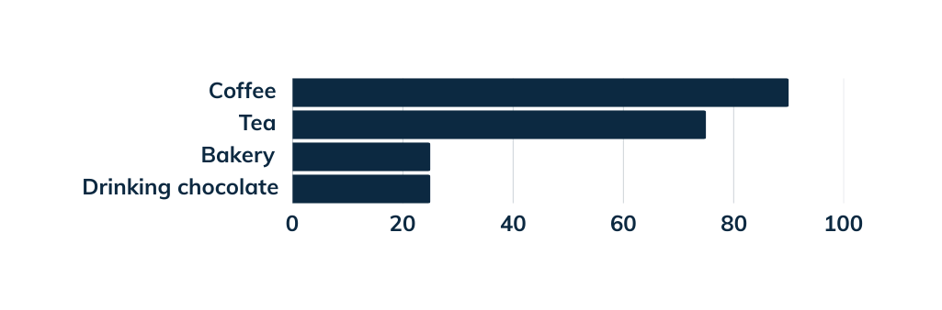
Product Performance
Understanding product performance is crucial for identifying top-selling items, optimizing inventory, and making informed decisions that drive business growth and enhance customer satisfaction.
Top selling categories

Slide 10
Product Performance
Sustainable Grown Organic Lg
Understanding product performance is crucial for identifying top-selling items, optimizing inventory, and making informed decisions that drive business growth and enhance customer satisfaction.
Most profitable product

Slide 11
Product Performance
Understanding product performance is crucial for identifying top-selling items, optimizing inventory, and making informed decisions that drive business growth and enhance customer satisfaction.
Dark chocolate
Low profit item

Slide 12
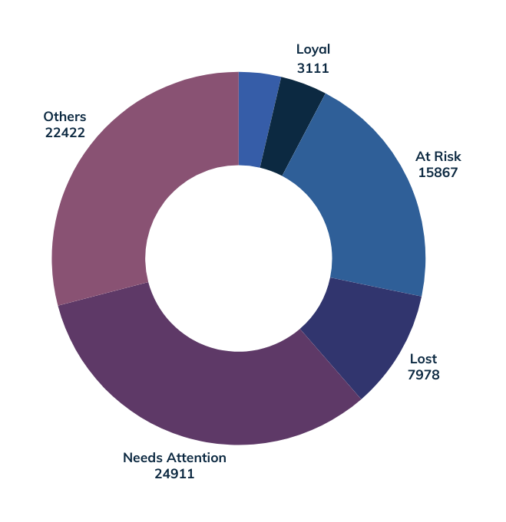
Overview of RFM analysis
Customer Segmentation (RFM Analysis)
RFM analysis revealed that the majority of customers fall into the "Needs Attention" (24,911) and "At Risk" (15,867) segments, highlighting significant opportunities for re-engagement strategies. Targeting these groups can help boost retention and improve overall customer lifetime value.

Slide 13

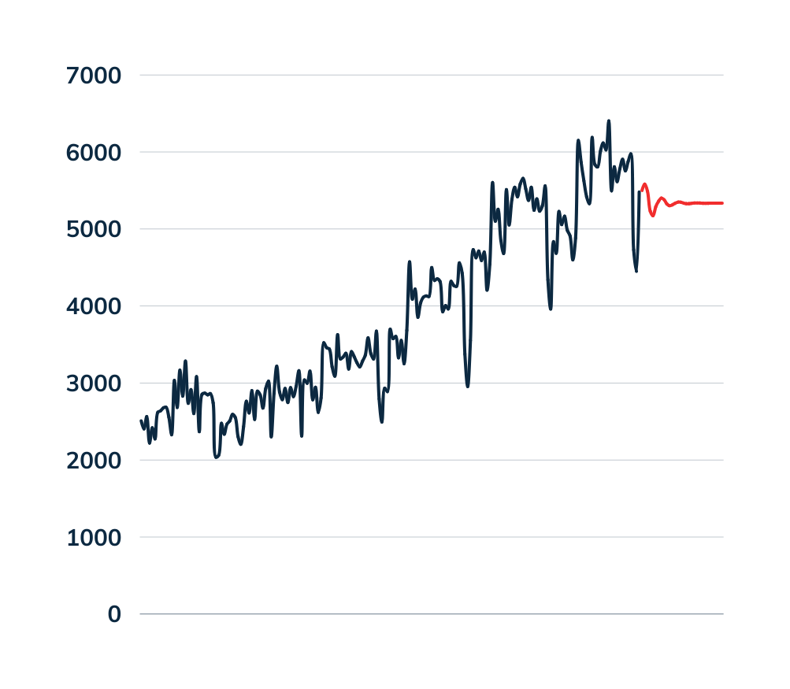
Forecasting Techniques
Overview of time series models
ARIMA Forecast Plot for (manual select)

Slide 14
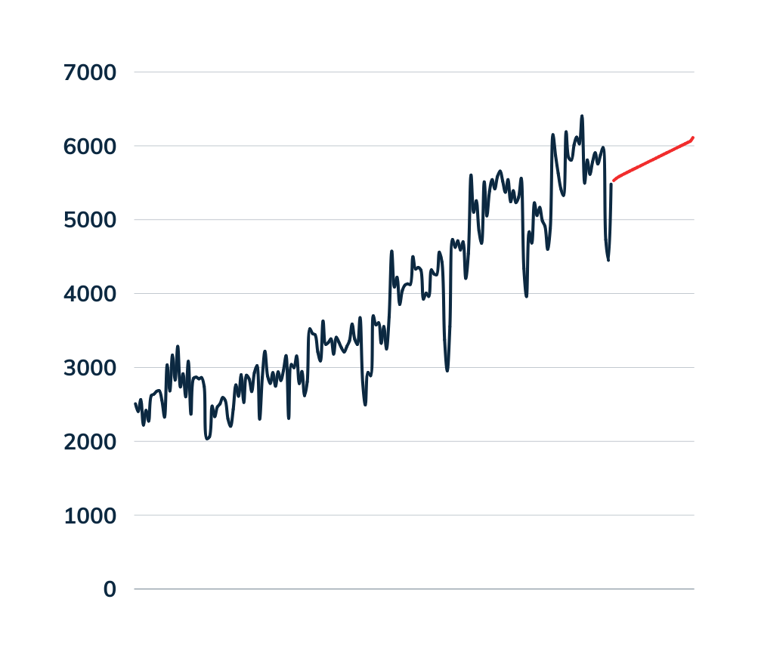
Forecasting Techniques
Overview of time series models
ARIMA Forecast Plot for (auto select)
Best ARIMA parameters: (1, 2, 2)
AIC: 2631.651397011826

Slide 15
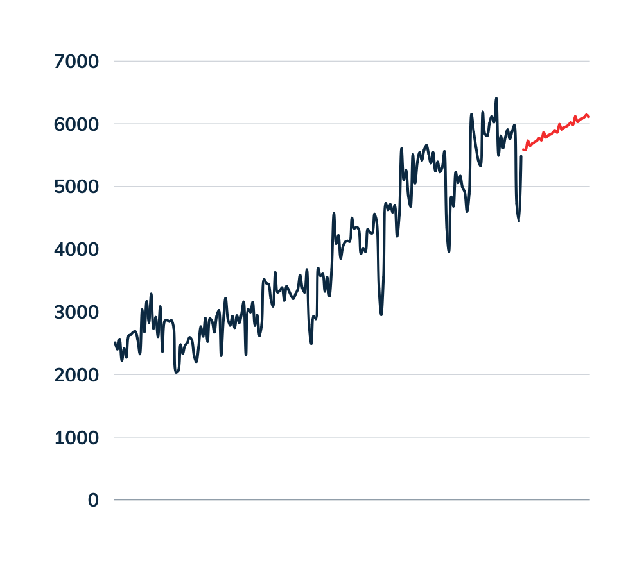
Forecasting Techniques
Overview of time series models
SARIMA (Seasonal ARIMA) Forecasting
Best ARIMA parameters: (1, 1, 1), (0, 1, 1)
AIC: 2429.046115603226

Slide 16


Operational Improvements
Strategic staffing during peak hours
Inventory optimization for high-margin products
Product placement enhancements
This improvement has led to reduced operational costs and enhanced customer satisfaction throughout the coffee shop's processes.

Slide 17
Marketing Strategies
Targeted retention campaigns
Loyalty program development
Seasonal promotion planning

Slide 18
Pricing Optimization
Time-based pricing strategies
Product bundling opportunities

Slide 19
Conclusion
Key Takeaways
Coffee dominates revenue
Customer segments reveal targeted marketing opportunities
Forecasting models provide reliable projections

Slide 20
Conclusion
Business Impact
Improved resource allocation
Data-driven marketing
Enhanced pricing strategies

Slide 21
Thank you

